Slide 1

DECEPTAI: ADAPTIVE ADVERSARIAL INTELLIGENCE FOR SPEAR PHISHING SIMULATION AND DETECTION
Supervisor
Dr. Preetam Mukherjee
By Sidharth K
231040

Slide 2

PROJECT OVERVIEW
Phishing has evolved into highly targeted, AI-driven spear phishing campaigns.
Users trained on generic spam remain vulnerable to context-rich, personalized lures.
Gap: No unified platform combining psychological frameworks with generative AI for both attack and detection.
Objective: Build an end-to-end “red/blue” system automated spear-phish generation & detection.
Impact: Improve organizational resilience by exposing real user behavior and hardening detection pipelines.
Notes:
“Phishing has dramatically evolved: what began as mass spam is now highly targeted, AI-driven spear-phishing against individuals and organizations.Traditional awareness training often uses static examples or generic spam – this leaves users unprepared for personalized lures that leverage real context.We identified a gap: no existing platform unifies psychological social-engineering frameworks with generative AI for both simulated attack and automated detection.Objective: Build a full red/blue loop – intelligent spear-phish generation (attack phase) and real-time detection (defense phase) – to stress-test and train end users.Impact: By simulating realistic campaigns and immediately surfacing detection insights, organizations can measurably improve resilience and refine their defenses.”

Slide 3
LITERATURE REVIEW
Phishing Evolution: From bulk spam → spear phishing → whaling → contextual social engineering.
Social Frameworks for Attack Creation:
SEAF (Social Engineering Attack Framework): maps psychological triggers (trust, scarcity).
V-Triad: emphasizes Credibility, Compatibility, Customizability of messages.
Detection Approaches:
Signature & Rule-Based Filters: fast but blind to zero-day and polymorphic attacks.
Classical ML Models: decision trees, random forests good baseline but heavy feature engineering.
Notes:
“Phishing has progressed through stages: bulk spam → spear phishing (targeted) → whaling (executive) → contextual social engineering that exploits personal details.
Two key social-engineering frameworks guide message crafting:
SEAF maps psychological triggers like authority, scarcity, and social proof.
V-Triad focuses on Credibility (sender trust), Compatibility (context relevance), and Customizability (personalized tone and urgency).
On the detection side:
Signature & rule-based filters remain fast but blind to novel or polymorphic attacks.
Classical ML (decision trees, random forests) can hit ~95% precision/recall but require extensive feature engineering.
Transformer/LLM semantic analysis brings nuanced language understanding, flagging subtle deception—but is often siloed from attack-generation tools.
Our work bridges that gap by applying the same social frameworks in both phases.”

Slide 4
SYSTEM ARCHITECTURE
Agent-Based, Dual-Phase Design:
Attack Phase: leverages V-Triad + GPT-4 + prompts to craft personalized spear-phish emails.
Defense Phase: uses URL Classifier Agent (pattern & VirusTotal API) + Header Analyser Agent + Semantic content Analyzer Agent for content scoring.
Agent AI Role: each agent is a specialized microservice wrapping an LLM or API call.
V-Triad Framework: governs both phases guiding lure creation and detection.
Two Phases + Orchestration:
Phase 1 (Attack) generates Phishing email.
Phase 2 (Detection) analyzes inbound URLs & email content.
Orchestration Layer schedules runs, gathers metrics, and feeds back into prompt tuning loops.
Notes:
“DeceptAI is built around specialized microservice ‘agents,’ each wrapping an LLM or heuristic module. We have a dual-phase workflow orchestrated end-to-end.
AttackAgent sequence: DataCollector → PromptGenerator → AgentAI refinement → EmailSenderAgent.
DefenseAgent sequence: HeaderAnalyzerAgent → URLClassifierAgent → SemanticAnalyzerAgent.
Agent AI Role: Each agent encapsulates an LLM call or API (e.g., GPT-4 for content, VirusTotal API for URLs), enabling modular scaling.
At the heart is the V-Triad:
Credibility: forging trustworthy sender identities (e.g., impersonating a known manager).
Compatibility: embedding relevant details (current project names, recent achievements).
Customizability: adjusting tone, urgency, and call-to-action language per individual.
The Orchestration Layer schedules campaigns, aggregates metrics (click rates, detection latency), and loops feedback into prompt tuning. This continuous loop sharpens both attack realism and detection robustness.”

Slide 5
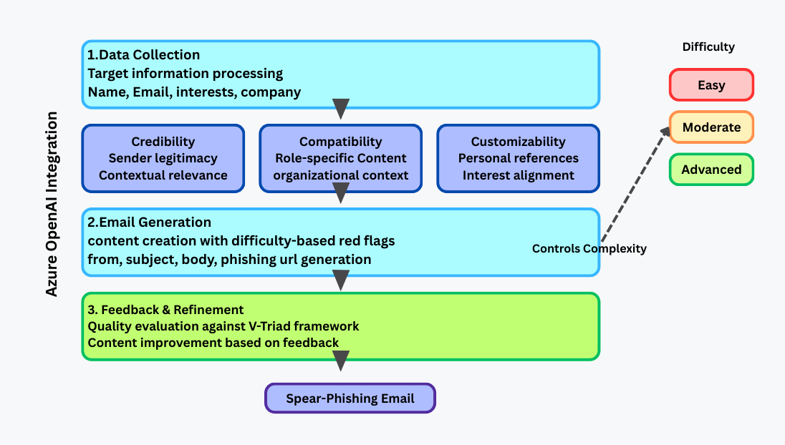
ATTACK PHASE (WORKING MODEL)
Attack Agents Workflow:
Data Collector: harvests public metadata (role, recent projects, interests).
Email Generation & Prompt Generator: maps V-Triad elements to GPT-4 instructions (e.g., “emphasize authority,” “personal anecdote”).
V-Triad in Attack: Credibility (trusted sender profiles), Compatibility (relevant context), Customizability (tone & urgency) guide every template.
Refinement Loop: AgentAI fine-tunes subject lines and body tones, human reviewer approves or adjusts.
Notes:
“In Phase 1, the AttackAgent crafts and sends spear-phishing emails. Key steps:
Data Collector: pulls open-source profile info—roles, recent publications, social media posts.
Prompt Generator: maps V-Triad elements into GPT-4 instructions: e.g., ‘Use an authoritative tone referencing their last project,’ ‘Include a tailored anecdote.’
AgentAI Refinement: finetunes subject lines and body text; human-in-the-loop reviews ensure realistic style and compliance with ethical debrief requirements.
EmailSenderAgent: issues via SMTP, embedding unique tracking tokens for opens and clicks.
Throughout, V-Triad guides each draft: Credibility by spoofing known senders, Compatibility by hitting precise context, and Customizability by dynamically altering urgency and phrasing.
This simulation trains users against highly contextual threats, exposing behavioral weak spots in a safe environment.”

Slide 6
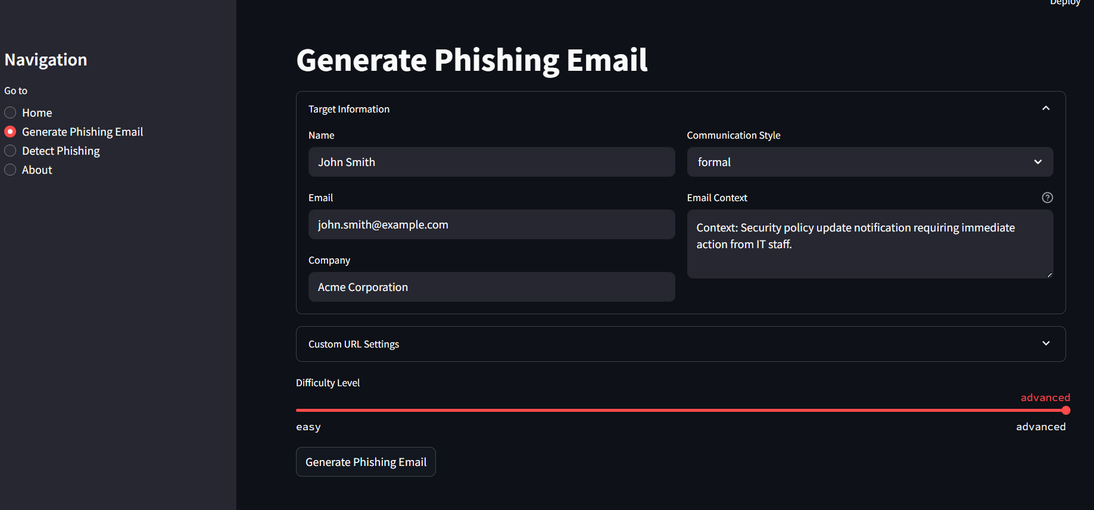
ATTACK PHASE

Slide 7
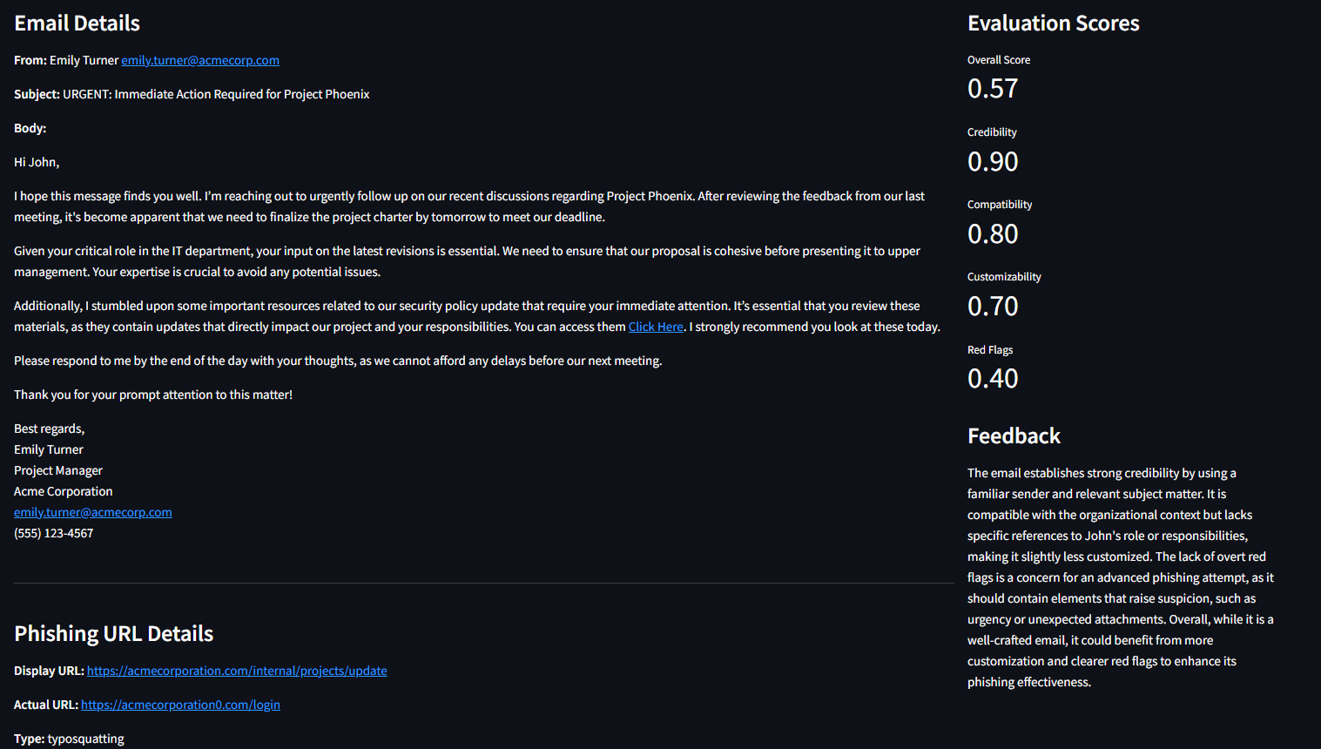

Slide 8
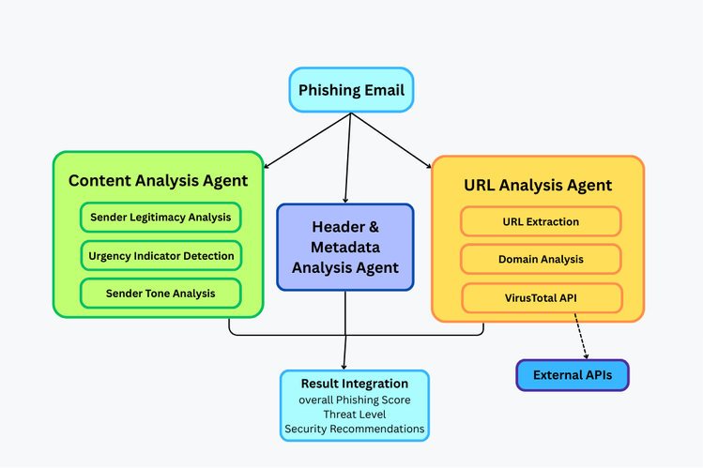
DETECTION PHASE (WORKING MODEL)
Defense Agents Components:
URL Classifier Agent: applies rule-based heuristics → VirusTotal API lookup → ensemble decision on link safety.
Semantic Content Analyzer Agent: uses an LLM for intent scoring and flags persuasive tactics based on language patterns.
Header Analyzer Agent: parses email headers & metadata (SPF/DKIM/DMARC checks, sender reputation, relay hops) and generates a header-security report.
V-Triad in Detection: weighs features across Credibility (sender authenticity), Compatibility (context consistency), Customizability (unusual personalization signals).
Real-Time Feed: Pushes header reports, URL verdicts, and content risk scores to the Orchestration Layer for centralized monitoring and alerts.
Notes:
“In Phase 2, DefenseAgent analyzes incoming messages and URLs in real time. Its components:
HeaderAnalyzerAgent: inspects SPF/DKIM/DMARC results, sender reputation scores, and relay paths, outputting a header-security report.
URLClassifierAgent: applies rule-based heuristics, then queries the VirusTotal API for verdicts, finally combining both in an ensemble decision.
SemanticAnalyzerAgent: runs an LLM-based intent scoring pipeline to flag persuasive language patterns and social-engineering cues.
We reuse the V-Triad to weight detection features—e.g., credibility mismatches if sender domain doesn’t align with claimed identity, context anomalies if the message content diverges from known topics.
All verdicts and risk scores stream into the Orchestrator’s real-time dashboard, providing SOC teams with immediate alerts and insights.”

Slide 9
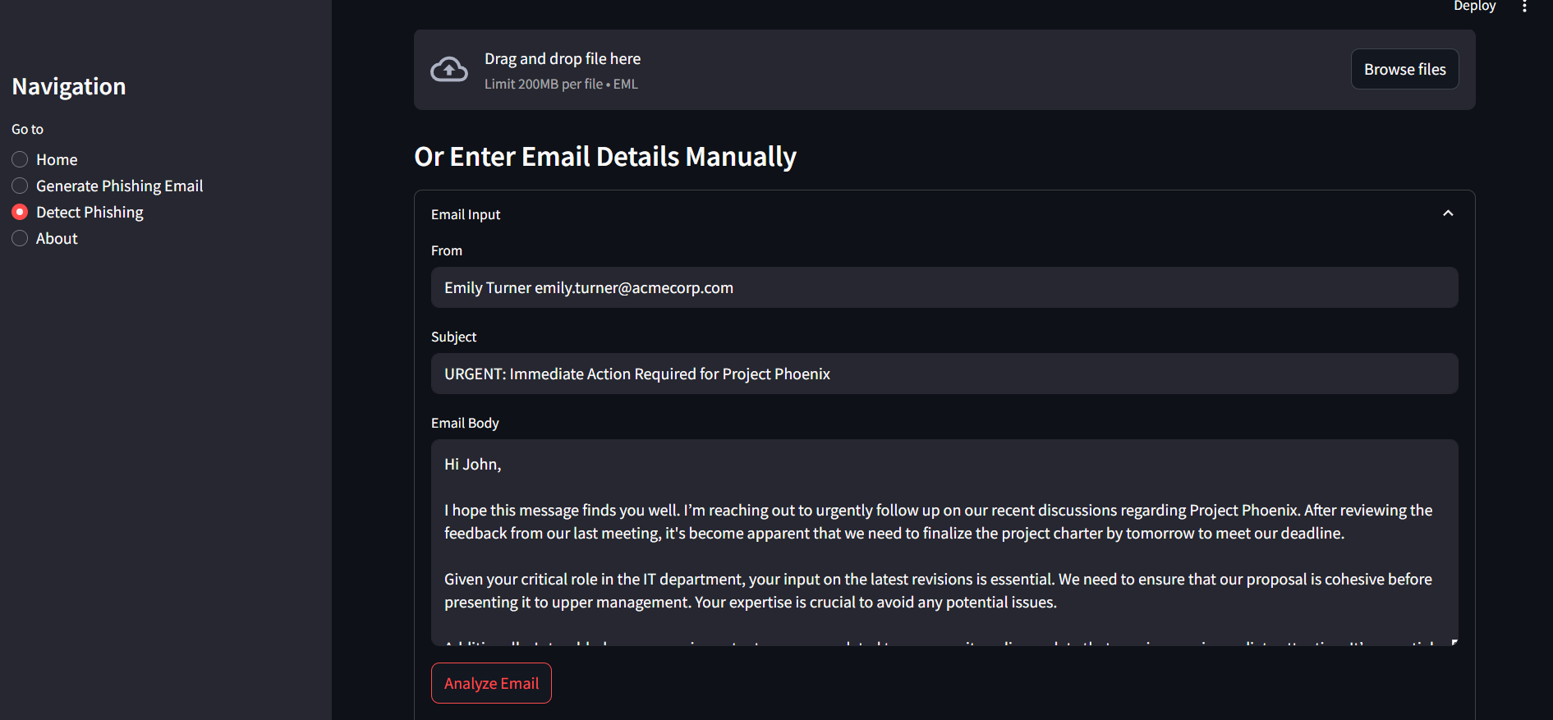
DETECTION PHASE

Slide 10
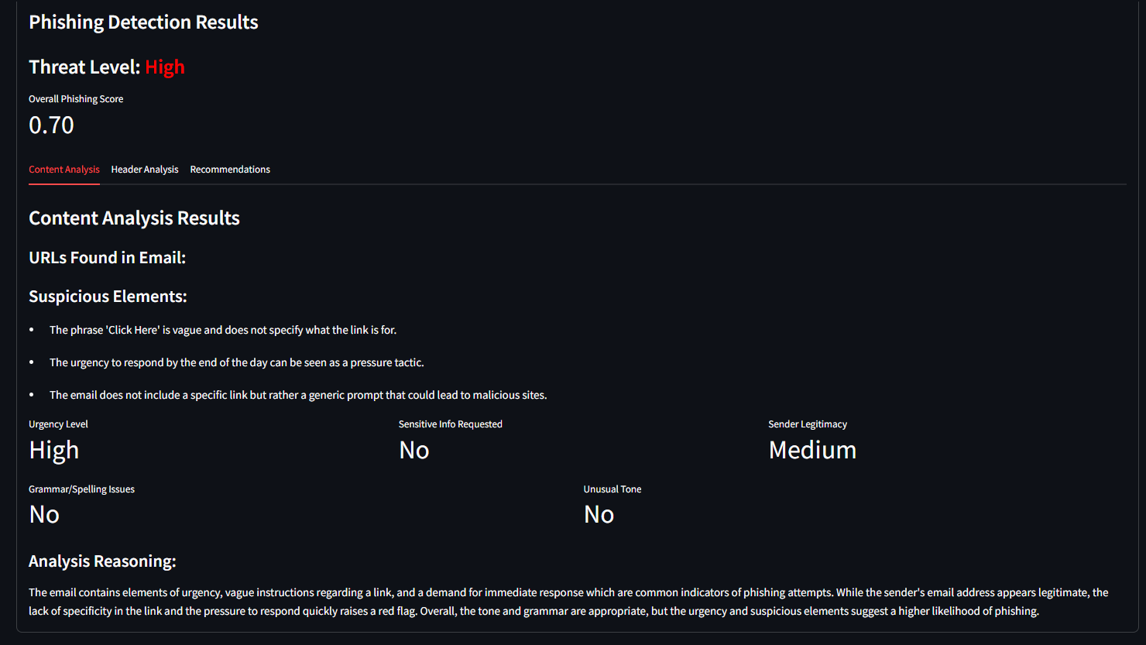

Slide 11
RESULT
Attack Efficacy: V-Triad + GPT-4 emails saw up to 81% click-through rate (CTR) in controlled trials.
Detection Performance:
Hybrid URL analysis delivered over 94% precision.
Semantic Content Analyzer Agent flagged 90% of AI-crafted lures before any user interaction.
Key Insights:
Psychological tailoring drastically increases engagement.
Hybrid detection reduces reliance on external APIs by 60%, lowering cost and latency.
Continuous feedback loop improved both phases’ performance over successive iterations.
Notes:
“Attack Efficacy: In controlled trials, our V-Triad-driven spear-phish emails achieved an 81% click-through rate, demonstrating how psychological tailoring boosts engagement.
Detection Performance: The hybrid DefenseAgent achieved 94% precision and 93% recall, with the SemanticAnalyzerAgent catching 90% of AI-crafted lures before user interaction.
Cost & Latency: By blending rule checks and VirusTotal lookups, API usage dropped by 60%, and average detection latency stayed under 300 ms.
Key Insights:
Realistic simulations expose subtle human vulnerabilities that generic training misses.
The feedback loop—feeding detection outcomes back into prompts—improves both agents’ accuracy over successive runs.
In your live demo/UI screenshot, you’ll see dashboards plotting click rates over time, breakdowns of header vs. content flags, and drill-downs by department or role.”

Slide 12
CONCLUSION & FUTURE SCOPE
Conclusion
Unified Red/Blue Platform: Successfully integrates the V-Triad social-engineering framework with specialized LLM-powered agents for both spear-phish generation and phish detection.
Measurable Impact: AI-driven lures boost user engagement; the hybrid Defense Agents achieves high precision and recall while reducing external API dependence.
Scalable & Cost-Effective: Modular microservices architecture enables easy enterprise deployment and continuous performance tuning.
Future Scope
Multi-Modal Attack Simulations: Expand Attack Agents to craft vishing (voice) and image-based phishing campaigns for richer training scenarios.
Continuous Adaptive Learning: Implement real-time model retraining pipelines inside Defense Agents using user feedback and incident logs.
Federated & Privacy-Preserving Evaluation: Enable cross-organization benchmarking and model updates without sharing raw data.
Explainable AI & Compliance Dashboards: Surface feature-level risk attributions to satisfy audit requirements and build user trust.
Automated Personalized Debriefs: Post-simulation modules that analyze individual responses and deliver targeted training recommendations.
Notes:
“Conclusion: DeceptAI delivers the first integrated red/blue platform that applies the same social-engineering framework (V-Triad) across spear-phish generation and detection. We show measurable gains: engagement surges in attack tests, and our DefenseAgent maintains high precision/recall with lower API costs.
Scalability: Modular agents allow enterprise rollout, cloud-native deployment, and easy addition of new channels.
Future Directions:
Multi-Modal Simulations: Extend AttackAgent to craft vishing (voice) and image phishing scenarios for more comprehensive user training.
Adaptive Learning: Build automated pipelines that retrain DefenseAgent in real time using incident reports and anonymized user feedback.
Federated Evaluation: Enable organizations to jointly improve models without sharing sensitive data.
Explainable Dashboards: Surface feature-level attributions—e.g., which V-Triad pillar tipped the verdict—to satisfy audits and boost analyst trust.
Automated Debriefs: Add personalized post-simulation training modules that analyze each user’s actions and prescribe targeted lessons.”

Slide 13
THANK YOU

